Slide 1

SQL Case Study
SQL CASE STUDY
FOODIE-FI

Slide 2
INTRODUCTION:
Foodie-Fi is a cool website where you can sign up to watch lots of cooking shows from all over the world. Danny, who started Foodie-Fi, knows that to make the website even better, he has to look at what shows people like and how they watch them. This study is all about how Danny uses numbers to make good choices for Foodie-Fi, making it a favorite place for people who love food.
We’re going to look closely at two big pieces of information (tables) from the Foodie-Fi database and even try to make a totally new piece of information (table).

Slide 3

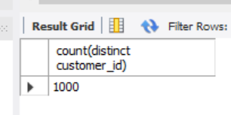
1. How many customers has Foodie-Fi ever had?

Slide 4
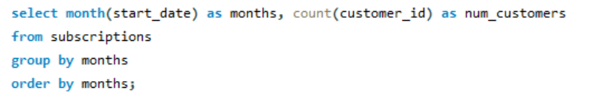
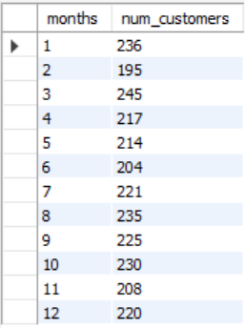
2. What is the monthly distribution of trial plan start_date values for our dataset - use the start of the month as the group by value?

Slide 5
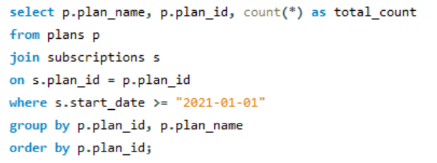
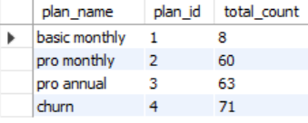
3. What plan start_date values occur after the year 2020 for our dataset? Show the breakdown by count of events for each plan_name?

Slide 6
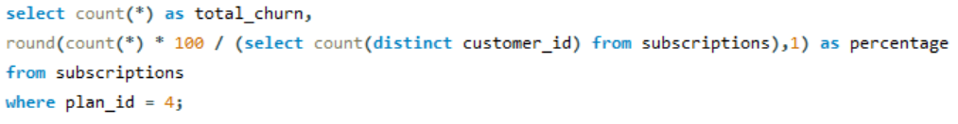

4. What is the customer count and percentage of customers who have churned rounded to 1 decimal place?

Slide 7
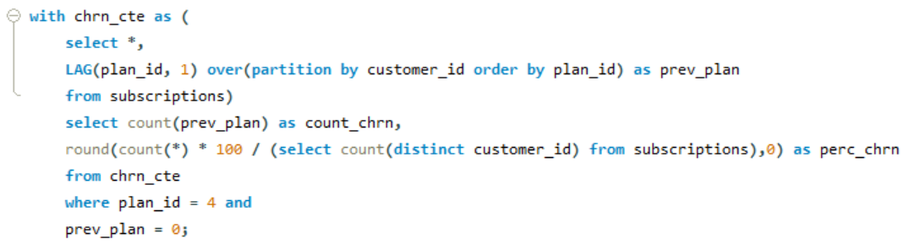

5. How many customers have churned straight after their initial free trial - what percentage is this rounded to the nearest whole number?

Slide 8
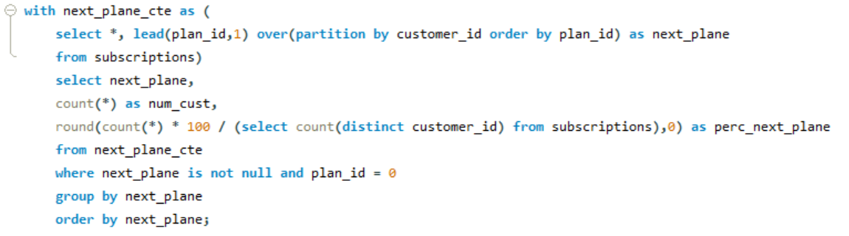
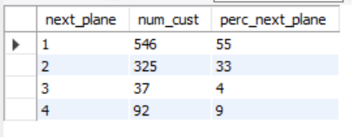
6. What is the number and percentage of customer plans after their initial free trial?

Slide 9
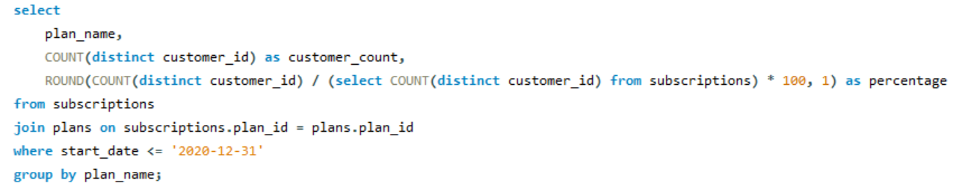
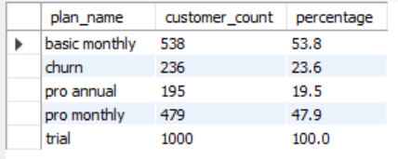
7. What is the customer count and percentage breakdown of all 5 plan_name values at 2020-12-31?

Slide 10
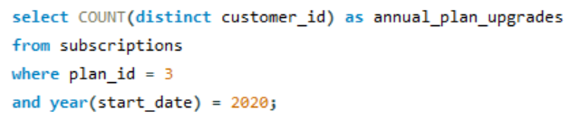

8. How many customers have upgraded to an annual plan in 2020?

Slide 11
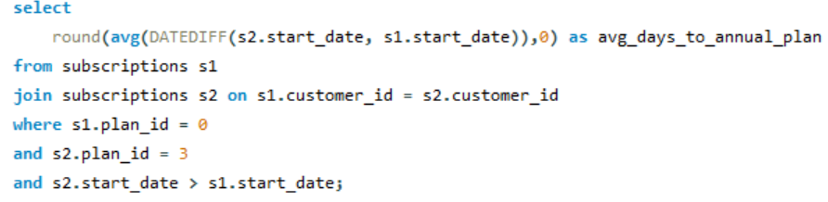

9. How many days on average does it take for a customer to an annual plan from the day they join Foodie-Fi?

Slide 12
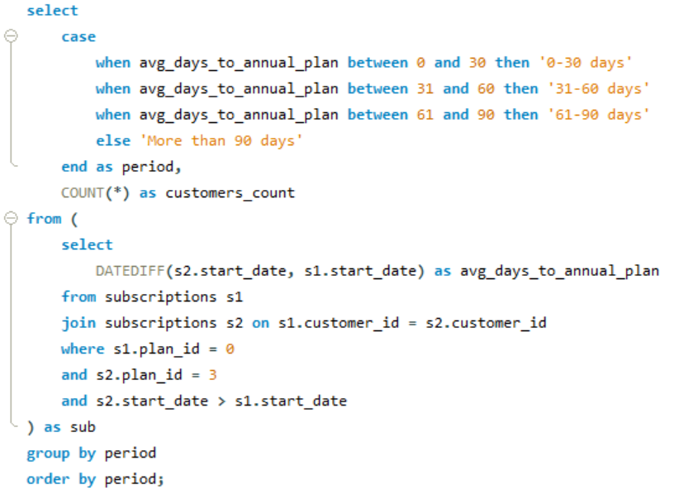
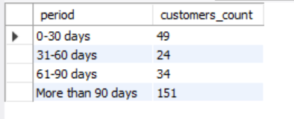
10. Can you further breakdown this average value into 30 day periods (i.e. 0-30 days, 31-60 days etc)?

Slide 13
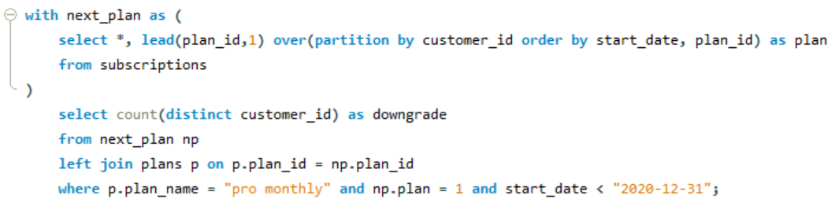

11. How many customers downgraded from a pro monthly to a basic monthly plan in 2020?

